Slide 1
Capstone Project - The Battle of Neighborhoods (Week 2)
Applied Data Science Capstone by IBM/Coursera

Slide 2
Introduction: Business Problem
This project is for who is planning to open a Coffee House in Seoul , Korea.
This project suggests the best locations for Coffee Houses in Seoul.
Seoul is the capital of Korea with a population of 10M.
Korea's coffee culture has developed rapidly over the past 20 years. The number of coffee shops has increased dramatically and is gaining huge popularity. Annual coffee consumption is also steadily increasing. According to a survey by the Hyundai Economic Research Institute, the number of coffee an adult drinks over a year continued to rise to 291 in 2015, 317 in 2016, 336 in 2017, and 353 in 2018.
This report explores which neighborhoods of Seoul have the most as well as the best Coffee Houses. Also, this project answers the questions “Where should I open an Coffee House?” and “Where should I stay If I want a tasty coffee?”

Slide 3
Data
District of Seoul are obtained from https://en.wikipedia.org/wiki/List_of_districts_of_Seoul
Latitude and Longitude values are obtained by using "geocoder".
All data related to locations will be obtaine by using FourSquare API and Python Libraries.

Slide 4
Methodology
Master data which includes “District”, “Latitude” and “Longitude” information of Seoul.
Python Folium library was used to visualize map of Seoul and its districts. In order to get Latitude and Longitudes of Seoul, geopy and geocoder are used. The map below was obtained.
In order to explore and categorize places Foursquare API was used. Limit was set to 100 and Radius was set to 500. Here is a head of the list Venues name, category, latitude and longitude information from Forsquare API. 25 venues are returned.
I will also use one-hot encoding to replace categorical data with numbers and perform clustering.

Slide 5
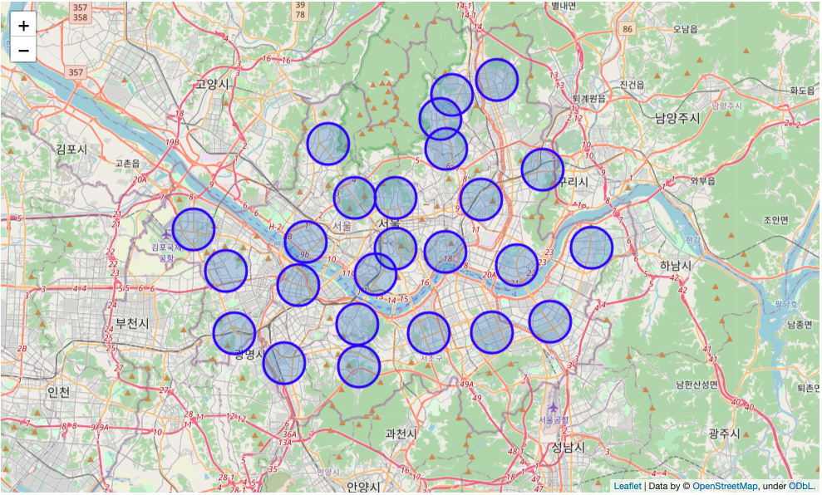

Slide 6
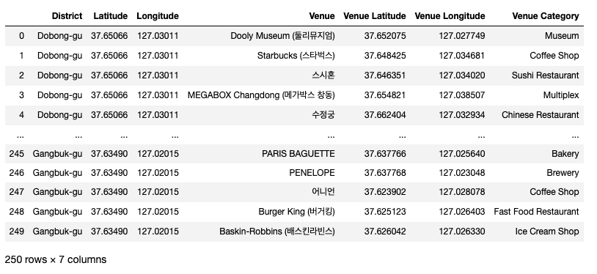

Slide 7
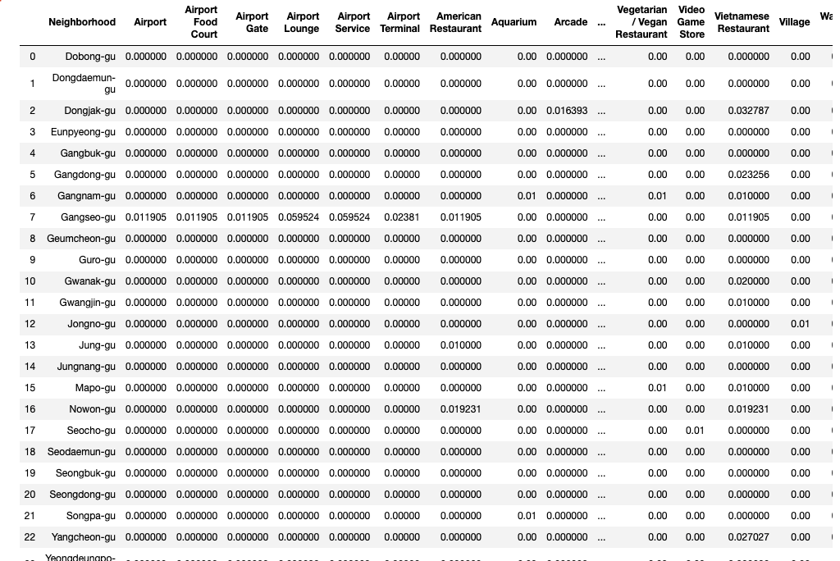

Slide 8
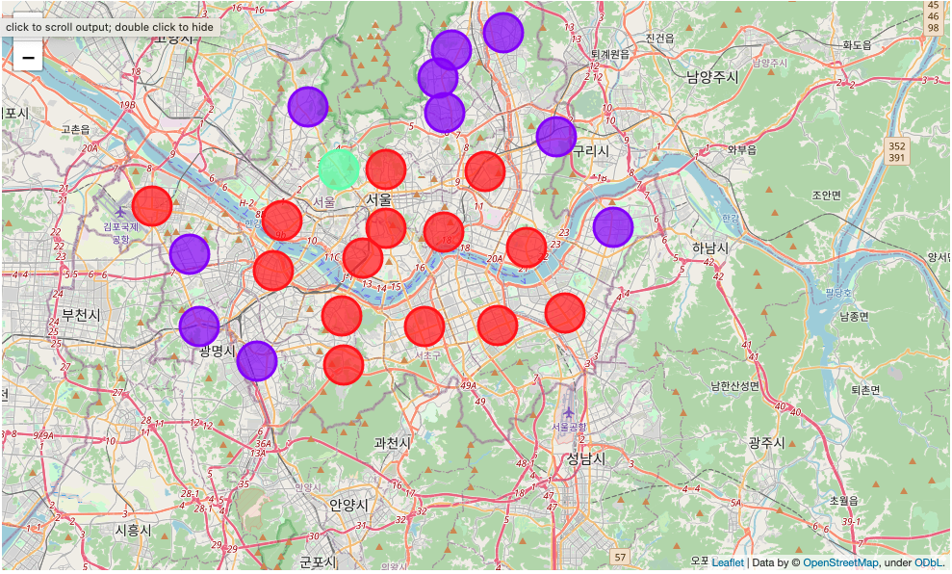
Analysis

Slide 9
Conclusion
Kmeans algorithm was used as part of this clustering study. K value was set to 3. For more detailed and accurate guidance, the data set can be expanded, and the details of the neighbourhood or street can also be drilled.
The areas of Cluster 0 and Cluster 1 seem to be suitable places to open new cafes.
The area with Cluster 0 is close to the center of Seoul, while the area with Cluster 1 is judged to be the periphery of Seoul. In addition, data such as real estate or floating population could be obtained to determine which areas are Cluster 0 and Cluster 1. In general, Cluster 0, which is the center of Seoul, has a high store rent and a large floating population, while Cluster 1 has a low store rent and a small floating population.

